Slide 1
Artificial Neural Network for Regression
Ginny Dang
Notes:
Classification is the branch of ML where you’re gonna predict some categories
Regression is the branch of ML where you’re gonna predict any continuous real values
Clustering is the branch of ML which is actually called unsupervised learning and consists of identifying some patterns in the data

Slide 2
Contents
01.
02.
03.
04.
Dataset Description
ANN Architectures
Results after training
Model
Demo
An overview of the dataset
Different versions of the ANN model
Compare the results after experiments
Running a demo of the ANN model

Slide 3
Dataset Description
An overview of the dataset

Slide 4
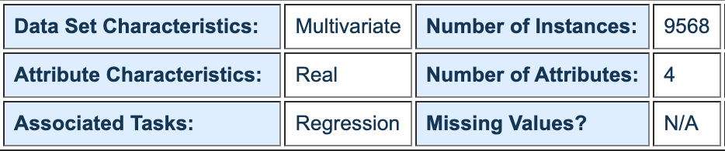
Combined Cycle Power Plant Data Set
Goal: Predicting the energy output in megawatt (MW)
Notes:
Multivariate dataset => several attributes are used to predict our dependent variable (the continuous outcome which is the net how the electrical energy output)
Attribute Characteristics are real number
Associated Tasks is regression => we’re gonna predict a continuous outcome (energy output in megawatt MW)
9568 Instances (observations) are used to train the ANN to understand the correlation between those attributes and the energy output.
There are 4 different attributes in this dataset which are discovered in the next slide
We don’t have any missing values in our dataset

Slide 5
Attribute Information
Features consist of hourly average ambient variables
Temperature
Ambient Pressure
Relative Humidity
Exhaust Vacuum
(T)
(AP)
(RH)
(V)
in the range 1.81°C and 37.11°C
in the range 992.89-1033.30 millibars
in the range 25.56% to 100.16%
in the range 25.36-81.56 cm Hg
Goal: Predicting the energy output in megawatt (MW)

Slide 6
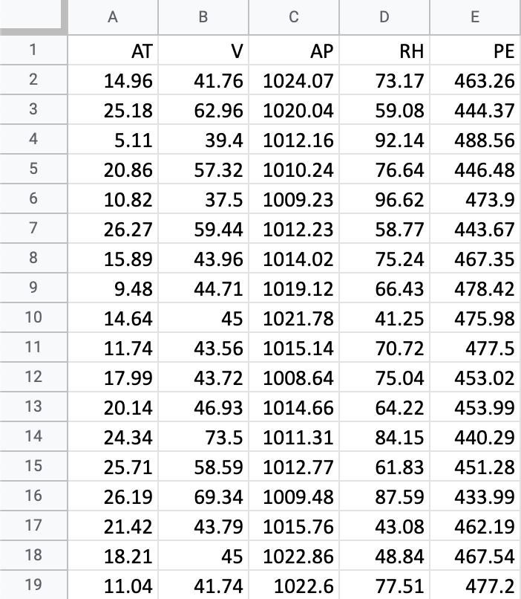
Data Snippet

Slide 7
ANN Architectures
Different versions of the ANN model

Slide 8
ANN Model A
2 hidden layers, 6 neurons per hidden layer
Input Layer
1st Hidden Layer
2nd Hidden Layer
Output Layer
1
7
X1
2
8
X2
3
9
y
X3
4
10
X4
5
11
6
12

Slide 9
ANN Model B
3 hidden layers, 6 neurons per hidden layer
Input Layer
1st Hidden Layer
2nd Hidden Layer
3rd Hidden Layer
Output Layer
1
7
13
X1
2
8
14
X2
3
9
15
y
X3
4
10
16
X4
5
11
17
6
12
18

Slide 10
ANN Model C
4 hidden layers, 6 neurons per hidden layer
1st Hidden Layer
2nd Hidden Layer
3rd Hidden Layer
4th Hidden Layer
Input Layer
1
7
13
19
X1
2
8
14
20
Output Layer
X2
3
9
15
21
y
X3
4
10
16
22
X4
5
11
17
23
6
12
18
24

Slide 11
ANN Model D
5 hidden layers, 6 neurons per hidden layer
1st
Hidden Layer
2nd
Hidden Layer
3rd
Hidden Layer
4th
Hidden Layer
5th
Hidden Layer
Input
Layer
1
7
13
19
25
X1
2
8
14
20
26
Output Layer
X2
3
9
15
21
27
y
X3
4
10
16
22
28
X4
5
11
17
23
29
6
12
18
24
30

Slide 12
Results after training
Compare the results after experiments

Slide 13
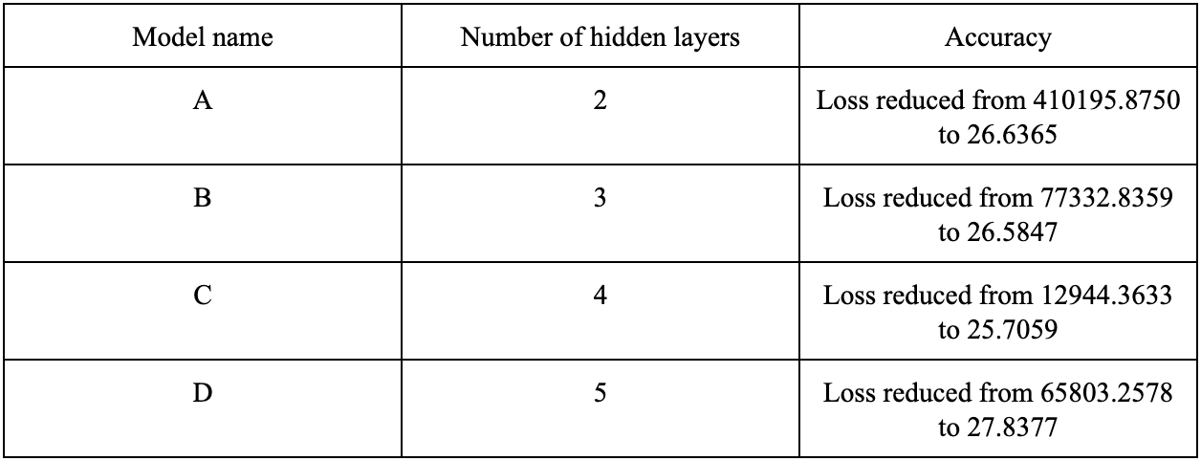
Model Performance
Notes:
Even though it appears that Model C has the best performance since its final loss is the lowest, it’s hard to say which one is the best model, since they are assigned different initial loss.

Slide 14
Demo
Running a demo of the ANN model

Slide 15
Thanks!

